Slide 1
CRONUS: A MUTIPURPOSE TERRESTRIAL CAMBOT
PROJECT CATEGORY:
DESIGN APPLICATION

Slide 2
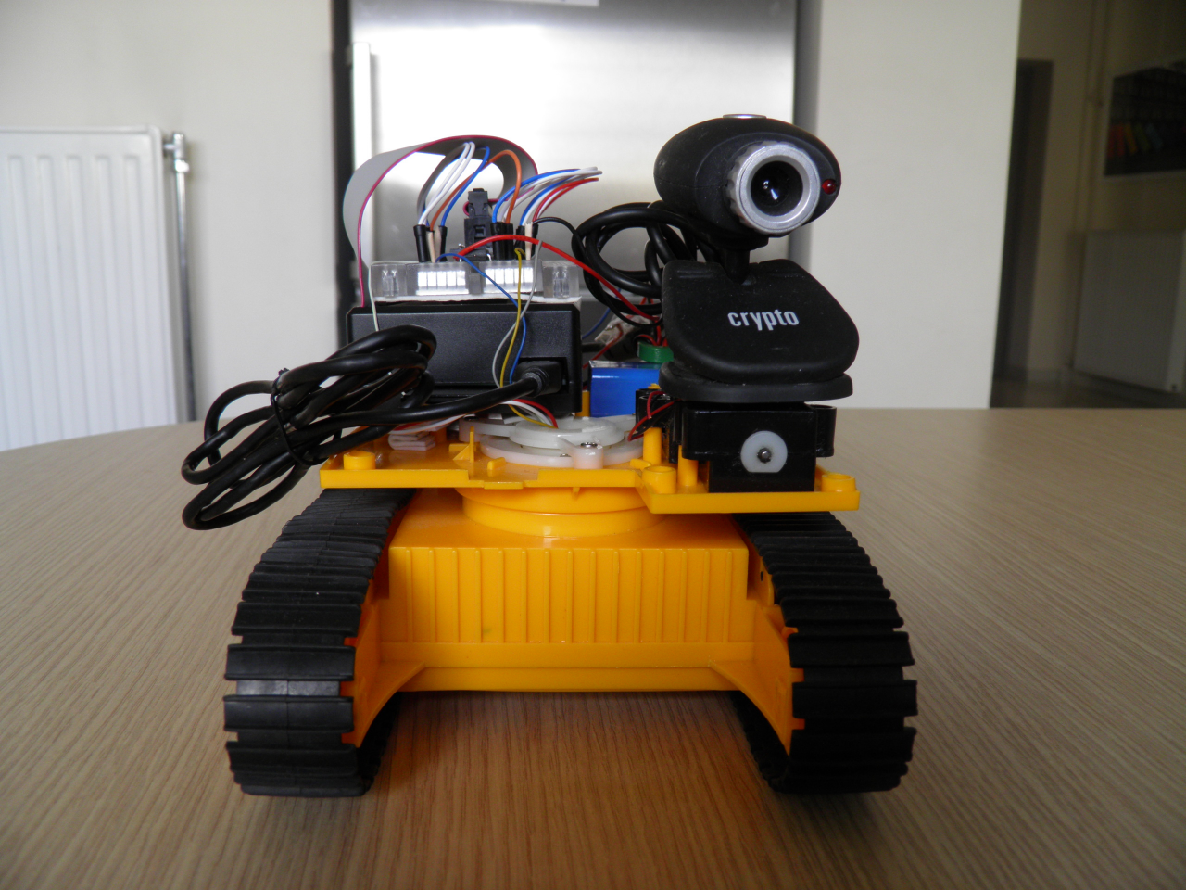
INDEX
Acknowledgement
Motivation
Innovation
Description
Limitations
Marketing Features
Costs
Additive Features( can be developed in the future)
Team Members

Slide 3
ACKNOWLEDGEMENT
We would like to express our heartfelt gratitude to The Director Dr. Ashoke Sarkar , The Vice Chancellor Prof. Souvik Bhattacharyya , the APOGEE Controls Department for organizing this competition and offering us a platform to showcase our project. We would also like to thank Dr. Abhijeet Asati , The EEE Department for helping and guiding us at every step, and making this project a success.

Slide 4
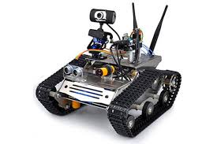
MOTIVATION
To explore security domain.
To make a multifunctional bot which could transition between various uses.
To enhance surveillance by using mobile cameras.
To demonstrate the working of various engineering disciplines in coordination.
To learn about working of various engineering
disciplines in coordination.rious control systems.

Slide 5
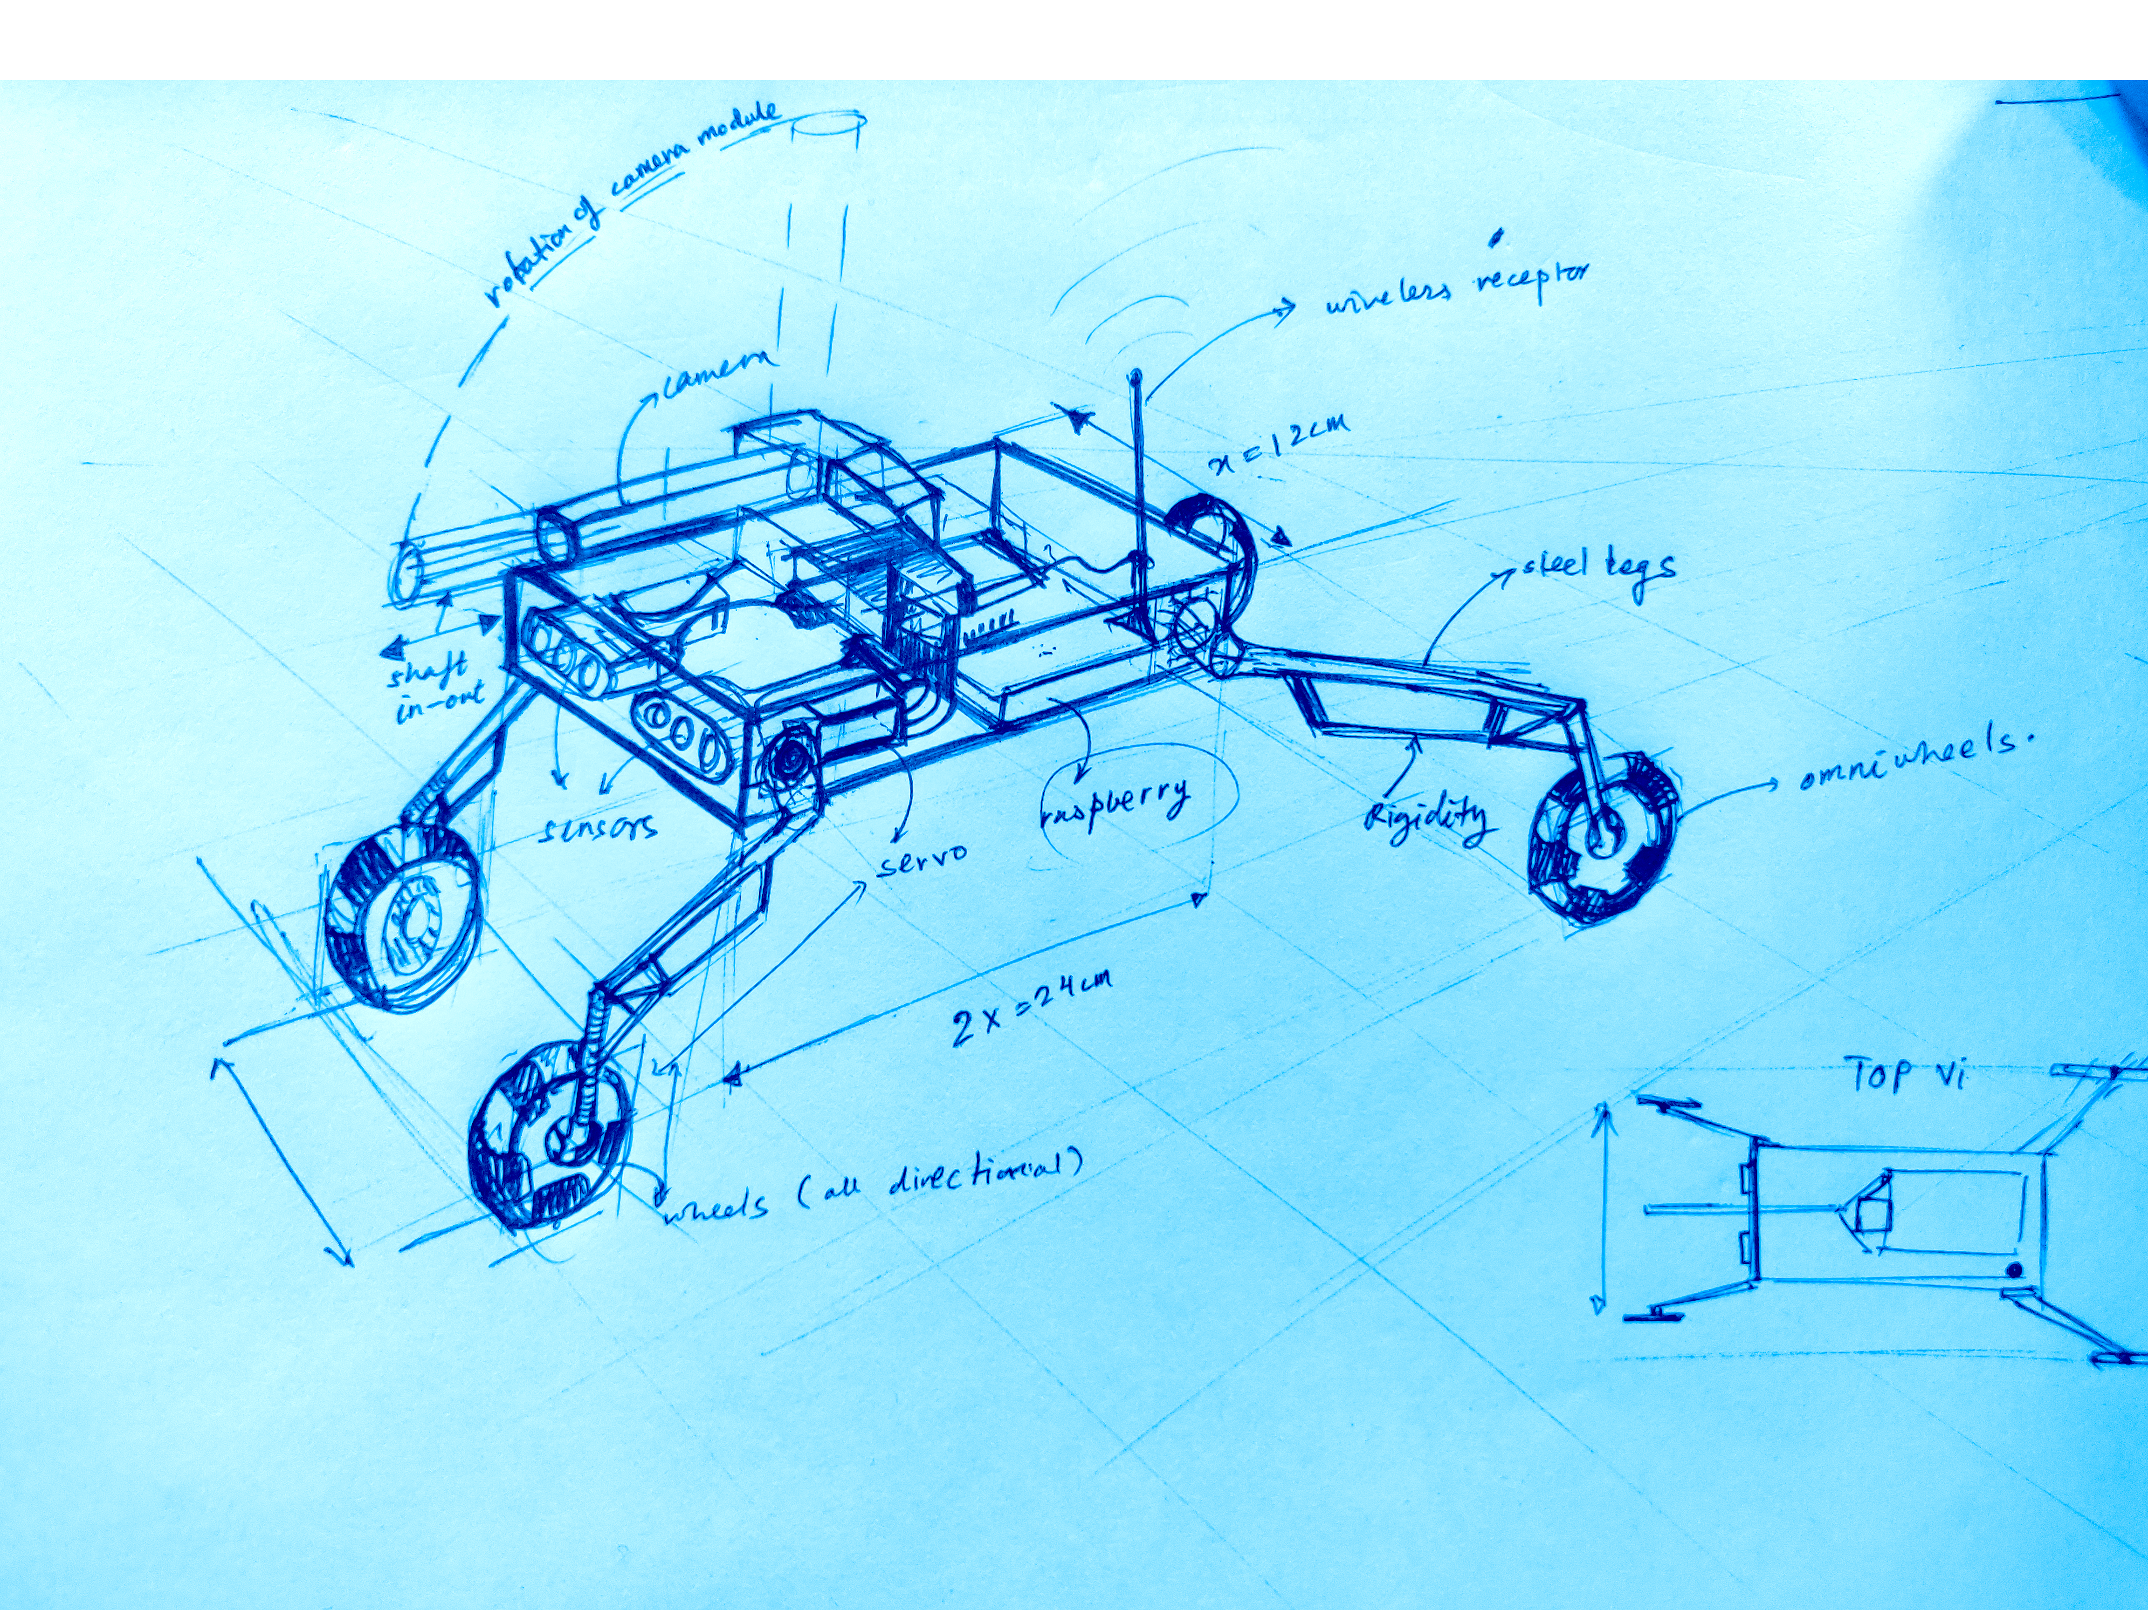
INNOVATION
Traditional surveillance cameras:
Are limited to a particular area.
Have blind spots.
Cannot look beneath objects.
Are relatively expensive.
Cronus solves these problems as:
Can be used for videography.
Mobility eliminates blind spots.
Height adjustment allows the user to explore areas inaccessible to normal camera footage as it can go beneath everyday objects like tables.
Can be produced at a relatively lower cost.
Holonomic drive mechanism makes it omnidirectional.

Slide 6
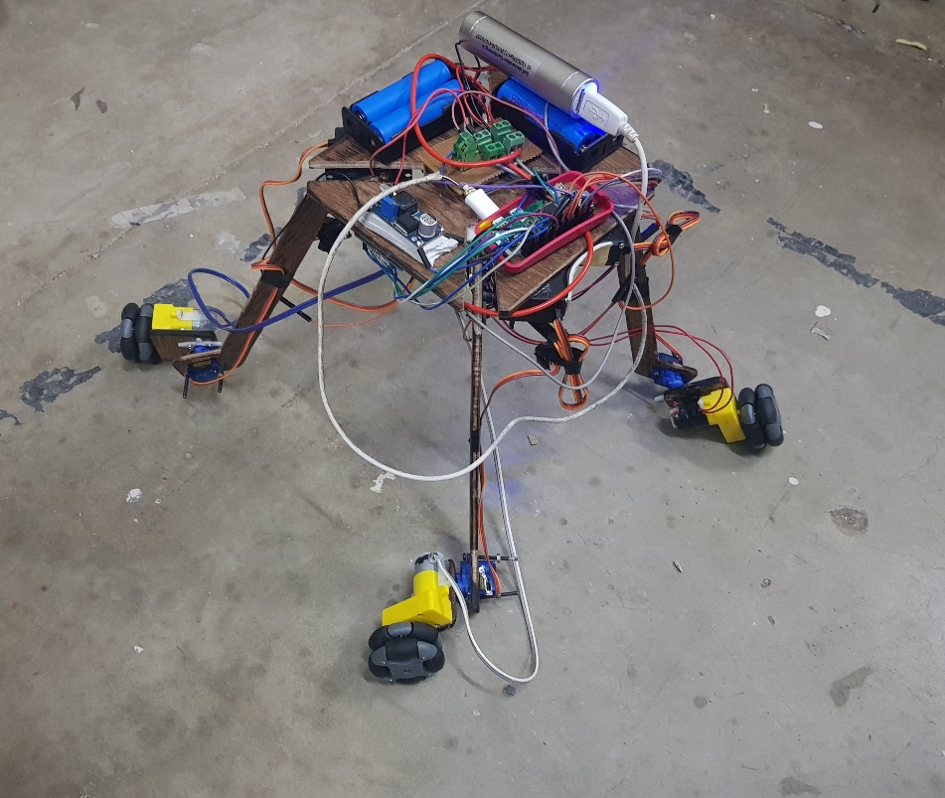
DESCRIPTION
Raspberry Pi 0 as the main microprocessor which controls 8 servos, 4 motors and a pi camera.
Four servos adjust the height of the robot.
The height adjusting servos could also be used to tilt the chassis.
The camera module will provide the video which will be uploaded to a Dropbox account and processed there.
Image processing includes face recognition.
The bot uses holonomic drive mechanism to
maneuver.
It is controlled through Wi-Fi using ssh.

Slide 7
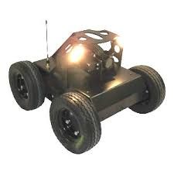
LIMITATIONS
The bot cannot climb over steps.
Due to material restrictions, the robot cannot sustain high stress.
The height achieved by the bot is restricted to a small range.
Real time processed footage will not be available due to transmission time lag.
Transmission might lead to a loss in a signal quality.

Slide 8
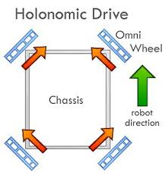
MARKETING FEATURES
The bot when produced and sold commercially will have the following features different from the prototype:
A 3-D printed chassis.
Higher quality camera.
Better aesthetics and secure wiring.
The bot will be sold as an assembled product.

Slide 9
COSTS
Cost of direct materials | ₹9,000
Cost of labour for assembly | ₹5,000
Cost of optimization of prototype(3-D printing, camera upgrade, etc.) | ₹3,000
Overhead and normal profit | ₹3,000
Total selling cost | ₹20,000

Slide 10
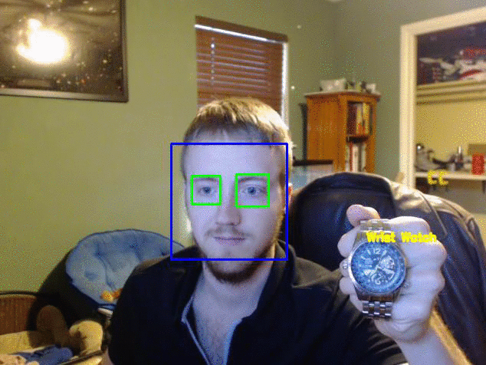
ADDITVE FEATURES( THAT CAN BE DEVELOPED IN FUTURE)
Multiple camera footage can be transmitted to a central server and processed there.
The bot can easily be made autonomous.
Can be used as an effective videography tool.

Slide 11
TEAM MEMBERS
Atharv Arora
Aayush Agarwal
Ananya Khandelwal
Ansh Shah
Jatin Agarwal

